Slide 1


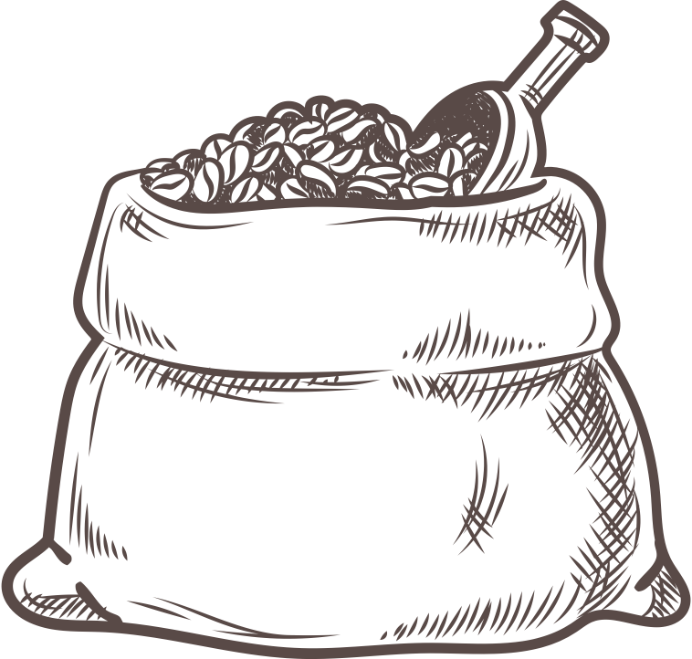
Brewediq
Coffee
Coffee Shop Sales Analysis
By- Rajat Kamble

Slide 2
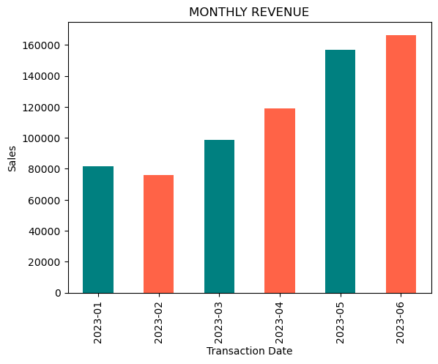
Monthly sales Trends Over Time
Key Insights on Monthly Sales Revenue :-
Sales Trend
Revenue shows seasonal variation higher sales during winter and festive months due to increased demand for hot beverages.
Summer months may see stable or slightly lower sales, but cold beverages and smoothies help maintain revenue.
Peak Days & Hours
Sales are consistently higher on weekdays (Monday–Friday).
Morning hours (7–10 AM) it is a peak timing and evening hours (5–8 PM) contribute most revenue, driven by office-goers and students.
Best-Selling Products
Cappuccino, Latte, and Cold Coffee generate the highest revenue among beverages.
Add-on items like cakes, sandwiches, and snacks significantly boost monthly revenue.
Customer Behavior
Regular customers contribute to 60–70% of recurring monthly revenue.
Introduction of loyalty programs or discounts can further increase retention and sales.
Growth Opportunities
Expanding takeaway and delivery services can increase monthly revenue by 15–20%.
Store Performance
Consistent monitoring of daily/weekly sales trends helps identify slow periods and plan targeted promotions.

Slide 3
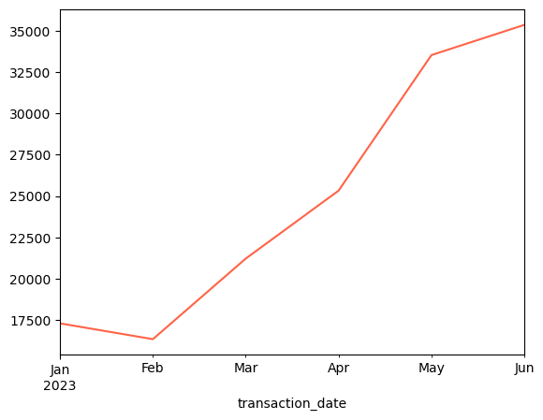
Monthly Transactions Trend
Key Insights on Monthly Transactions (Coffee Shop)
Steady Growth
Transactions started at 17,314 in January and steadily increased to 35,352 in June.
This shows more than 2x growth in just six months.
Seasonal Demand
A noticeable jump happened from March (21,229) to April (25,335), possibly due to summer demand and more customer visits.
Peak Performance
June recorded the highest transactions (35,352), making it the best-performing month in this period.
Customer Engagement
The rising trend suggests increasing customer loyalty and footfall every month.
Promotional offers, new menu items, or seasonal drinks may have contributed to this growth.
Business Insight
If this growth continues, the coffee shop could expect even higher transactions in upcoming months.
It indicates strong business expansion and revenue potential

Slide 4
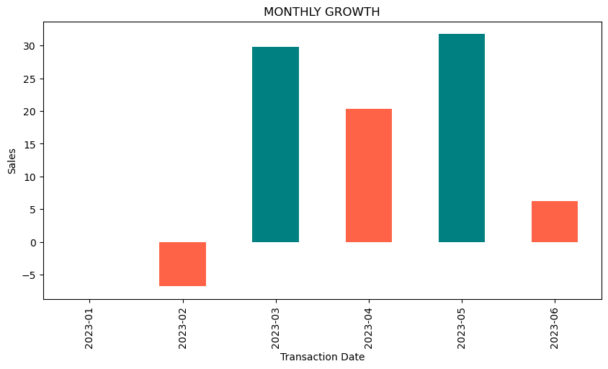
Month-over-Month growth Rate
Slow Start
February saw a drop of 6.8%, which means sales slowed down after January.
2. Strong Recovery
In March, growth bounced back sharply with a 30% increase, showing strong customer demand.
3. Consistent Growth
April continued this positive trend with 20% growth, showing stability in performance.
4. Peak Month
May was the best month, achieving the highest growth of 31.8%, indicating excellent sales performance.
5. Slight Slowdown
June still had positive growth (6.2%), but it was lower compared to previous months, showing some cooling in momentum.

Slide 5
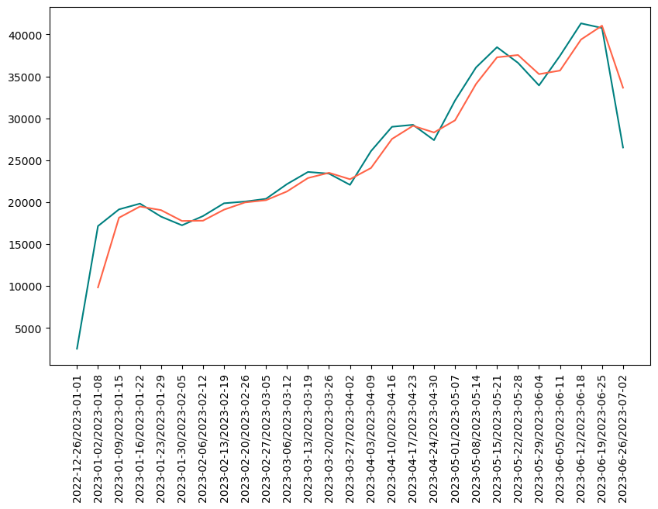
Moving Average
Strong Growth: Sales increased from ₹9.8K in Jan to a peak of ₹41K in June, showing steady business growth.
Best Performance Period: Mid-May to late June recorded the highest weekly sales (₹37K–₹41K), proving it was the strongest phase for the coffee shop.
Slight Decline at End of June: Sales dipped to ₹33K in the last week of June, suggesting a slowdown after the peak.
Overall Trend: The shop shows a clear upward sales trajectory, meaning demand and customer interest are growing month by month.

Slide 6
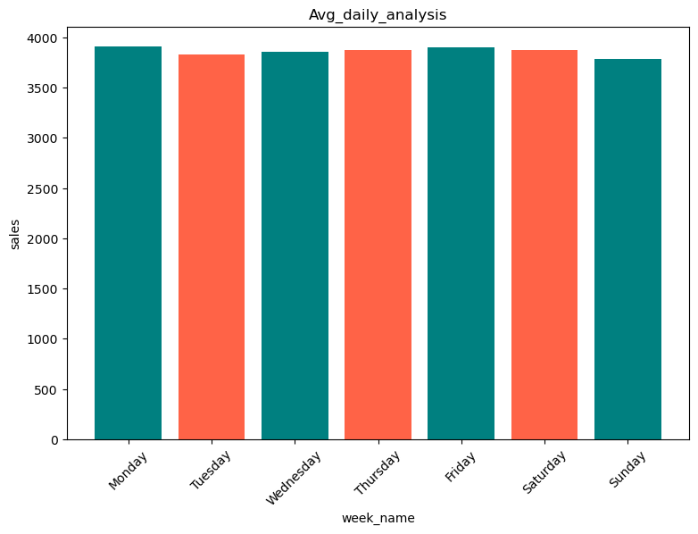
Average Daily Analysis
Stable Sales All Week
Sales are consistent across all days (₹3,800–₹3,900).
No major ups and downs, meaning customer flow is steady.
2. Best Day: Monday , Friday and Saturday
This days has the highest average sales (₹3,910).
3. Lowest Day: Sunday
These dips may be due to mid-week slowdown and Sunday rest/holiday effects.
4. Weekdays Slightly Stronger
Monday to Friday show slightly better performance compared to weekends . Indicates more sales come from the working population.

Slide 7
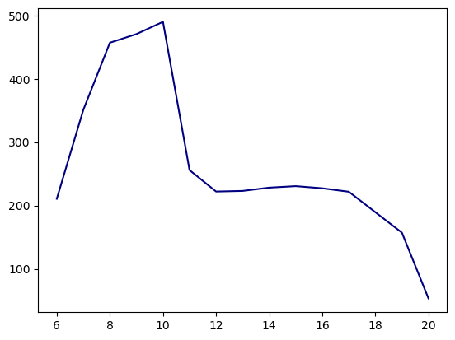
Hourly Analysis
Morning Peak (8 AM – 11 AM)
Sales rise quickly after 7 AM . Peak demand happens between 9 AM – 11 Am
2. Midday Drop (12 PM – 2 PM)
Sales d after 11 AM and stay lower around noon.
3. Evening Stability (3 PM – 6 PM)
Sales stabilize between 3 PM – 6 PM. A steady afternoon/evening coffee break crowd.
Late Evening Decline (7 PM – 8 PM)
Sales start reducing after 7 PM, and by 8 PM–9 PM, sales are minimal. Very few customers prefer late-night coffee.

Slide 8
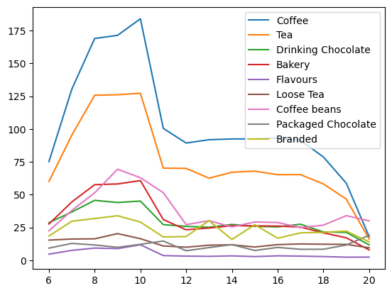
Hourly Sales By Product Category
Morning (8–10 AM)
Peak sales, Coffee , Tea , bakery, and drinking chocolate dominate
Biggest rush is in the Morning
2. Mid-Day (11– 2 PM)
sales drop after 11 AM (Coffee falls, Tea stable)
Moderate sales, tea & snacks.
3. Afternoon & Evening(2–8 PM)
Customers take afternoon tea/coffee breaks.
People finish work, fewer coffee drinkers.
After 6 PM Sharp decline, very low demand by 9 PM.

Slide 9
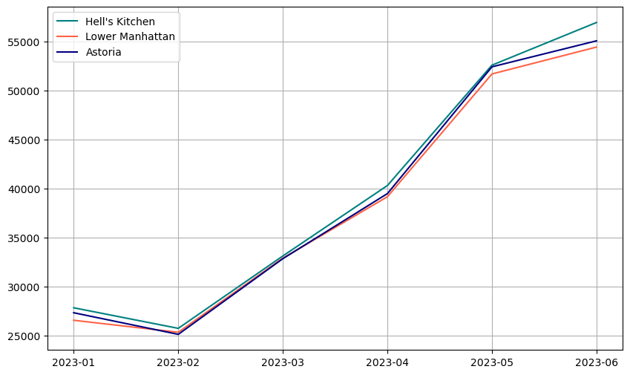
Store Rankings
Hell’s Kitchen: Best-performing store with the highest growth, climbing from ₹27.8K in January to ₹56.9K in June. Shows strong demand and consistent momentum. This suggests that Hell’s Kitchen has been gaining strong customer demand
Lower Manhattan: Consistent but slightly behind the other two (₹54.4K in June). Still growing well but not as fast as Hell’s Kitchen. Store is performing well and maintaining customer engagement.
Astoria: Stable performer, slightly ahead of Lower Manhattan in May–June (₹55K in June). Competitive and reliable. Astoria has a pattern very similar to Lower Manhattan

Slide 10
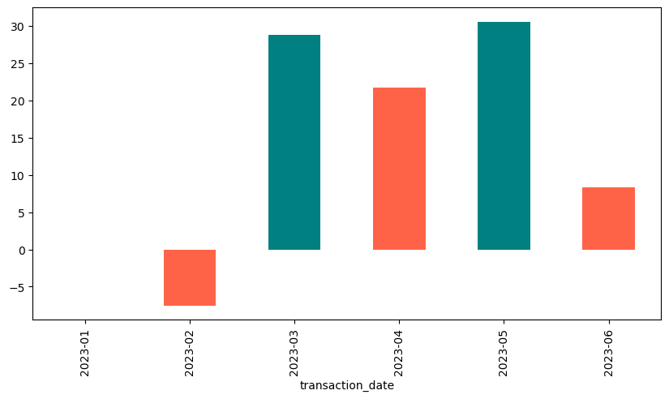
Hell’s Kitchen Month on Month Growth
January : No growth is shown because it’s the starting point.
February : Sales dropped by about 7.5% this shows that customers bought less because of seasonal reasons or lower demand after the New Year.
March : there was a big recovery growth showing strong improvement.
April : Growth slowed but still positive at around 21.7%, keeping the upward momentum.
May : The store saw its highest jump at 30.5%, a very strong boost in sales. The biggest leap in the whole six-month period.
June : The value experiences a sharp decline, ending at a positive but much lower value.

Slide 11
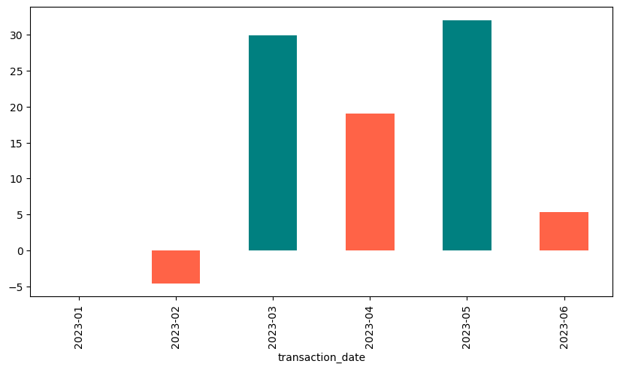
Lower Manhattan Month on Month Growth
February : sales went down compared to January, this shows that business slowed during this month, and customers were buying a little less than before.
March : There was a big improvement, Sales picked up strongly, and this month marked a clear recovery after the slowdown in February.
April : Sales continued to grow, but the speed of growth was a little less than March.
May : The business performed the best. Sales reached their highest growth in this period.
June : sales were still going up, but the rise was much smaller compared to the previous 5 months.

Slide 12
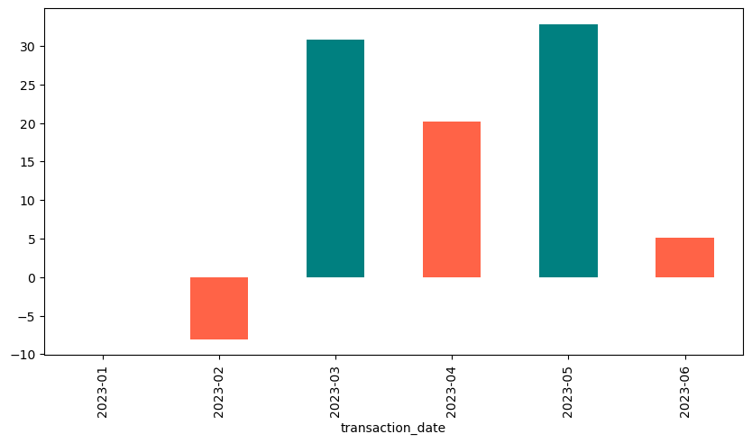
Astoria Month on Month Growth
February : The sales figure is negative, which is atypical for sales data( -7)
March : The value is positive and significantly high, around 31.
April: The value is positive, around 20.
May: The value is also positive and high, around 32, representing the highest value in the observed period.
June: The value is positive, around 5.

Slide 13
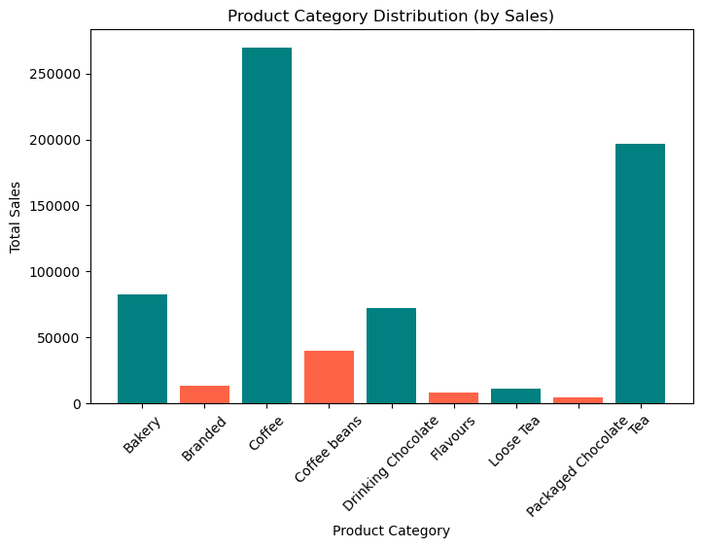
Product Category Distribution by Sales
The Coffee category has the highest total sales among all product categories, showing it is the most popular
Tea sales are also very strong, making it the second-best seller. Focusing on tea can further boost overall business growth.
Bakery and Drinking Chocolate categories show steady, reliable sales, indicating consistent customer interest but with room for more growth.
Lowest Selling Categories such as Branded, Flavours, Loose Tea , and Coffee Beans have much lower sales numbers and these products are less preferred by customers.

Slide 14
Product Category Distribution by Transaction
Coffee is the top-selling category
With nearly 90,000 units sold, coffee clearly dominates the product mix.
This shows strong customer preference and consistent demand.
2. Packaged Chocolate is the second strongest performer
Around 70,000 units sold, making it another key driver of sales.
3. Moderate demand categories
Bakery (23,000) and Drinking Chocolate (18,000) have decent sales but are far behind coffee and chocolates.
These can be seen as steady contributors rather than major revenue drivers.
4. Low-demand categories
Loose Tea, Branded items, and Coffee Beans sell very little compared to others.
5. Customer preference trend
Customers are clearly more drawn toward convenience (coffee, packaged chocolate) than specialty items.

Slide 15
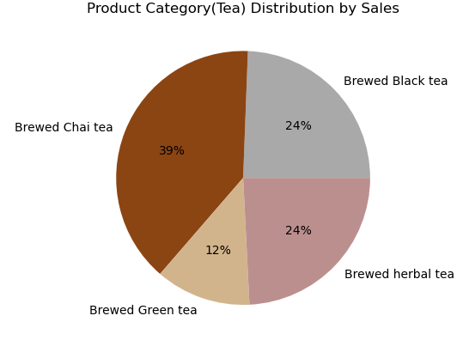
Product Category wise Sales Distribution
Brewed Chai tea accounts for the largest share of sales, representing 39% of the total tea sales shown in the chart.
Brewed Black tea and Brewed herbal tea share the second-largest portion equally, with each contributing 24% to the total sales.
Brewed Green tea holds the smallest share of sales among the categories presented, at 12%.

Slide 16
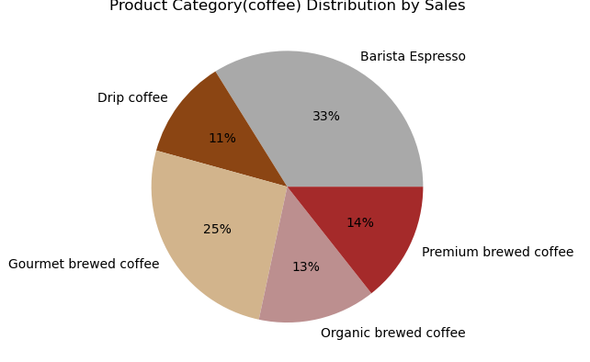
Product Category wise Sales Distribution
Barista Espresso accounts for the largest share of sales, representing 33% of the total, making it the most popular coffee product category by sales in this distribution.
Gourmet brewed coffee holds the second-largest share at 25% of total sales, indicating a significant preference for this category.
Premium brewed coffee and Organic brewed coffee have relatively similar contributions to sales, at 14% and 13% respectively.
Drip coffee constitutes the smallest portion of sales among the listed categories, with 11% of the total, indicating it is the least popular.

Slide 17
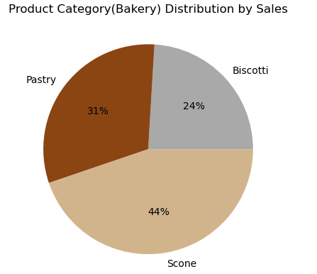
Product Category wise Sales Distribution
Scone is the highest-selling category, accounting for 44% of total bakery sales, indicating it is the most popular or highest revenue-generating product among the three.
Pastry holds the second-largest share with 31% of sales, demonstrating a significant contribution, though less than Scone.
Biscotti represents the smallest portion of sales at 24%, suggesting it is the least popular or lowest revenue-generating product among the three categories shown.

